Slide 1
基于细胞转录组的高通量药物组合筛选
清华大学药学院 药6
谭彭丞 2016013167

Slide 2
Model Introduction
Model for :
Transcriptome-based high-throughput screening of compound combinations for cell-type specific transcriptome
High-throughput screening of drugs that could induce iPSCs into specific cell types
Drug mechanism prediction
’
’
’
VAE loss = Reconstruction loss + KL Divergence loss
Model loss = X VAE loss + D VAE loss + Y reconstruction loss
Min, Erxue & Guo, Xifeng & Liu, Qiang & Zhang, Gen & Cui, Jianjing & Long, Jun. (2018). A Survey of Clustering with Deep Learning: From the Perspective of Network Architecture. IEEE Access. PP. 1-1. 10.1109/ACCESS.2018.2855437.

Slide 3
Data Preprocessing
Sample-by-gene matrix
Split matrix into small batch
Merge replicates
Match untreat gene expression (xi) to each treated sample (yi)
Drug SMILES
Construct drug features(Topological fingerprint, NumAtoms, MolWt, NumRings, NumArRings, NumHAcceptors, NumHDonors, NumRotBonds, NumNO, NumNHOH)
Match drug features to each sample(di)
’
’
’

Slide 4
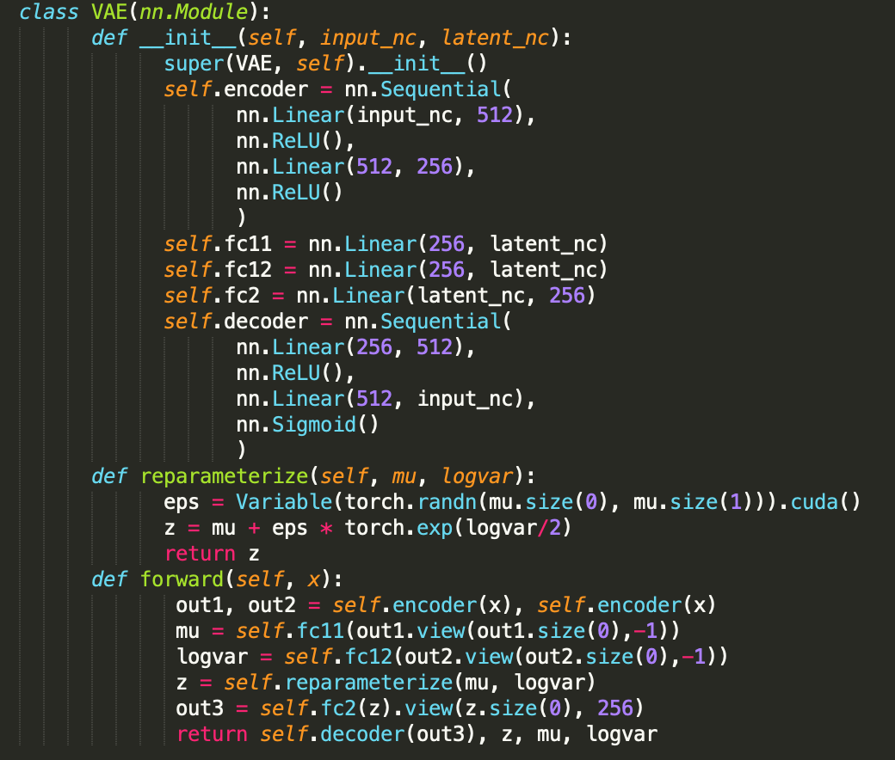
Model Structure
Parameters:
Type of layer:
Linear/Nonlinear
n_layer
n_latent

Slide 5
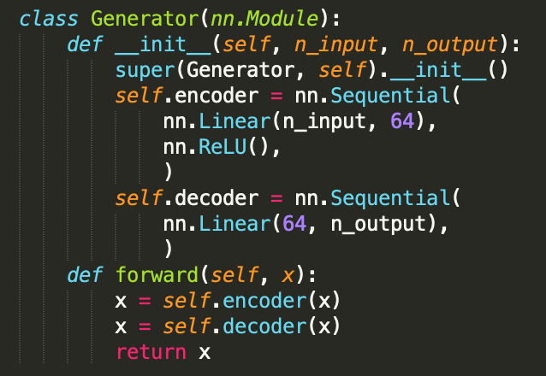
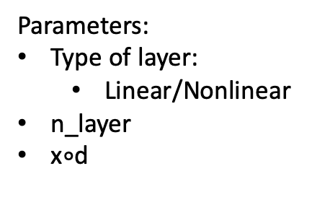
Model Structure
Parameters:
Type of layer:
Linear/Nonlinear
n_layer
x$∘$d

Slide 6
Criterion
Criterion:
Loss = MSE(x, x’) + MSE(d, d’) + MSE(y, y’) + KL-Divergence(Zx, N(0,1)), KL-Divergence(Zd, N(0,1))
Five-fold cross validation
Pearson correlation (y, y’)
Heatmap
Drug Rank

Slide 7
Preliminary Results
X
y
y_pred
Sample
Gene
Gene
Gene
Conclusions:
300-epoch training is enough
Low column correlation
Row correlation: 0.888 -> 0.904
Question:
Data similarity between x and y (normalize ?)

